Slide 1
Advances in the genetics of schizophrenia
Kipp Johnson

Slide 2
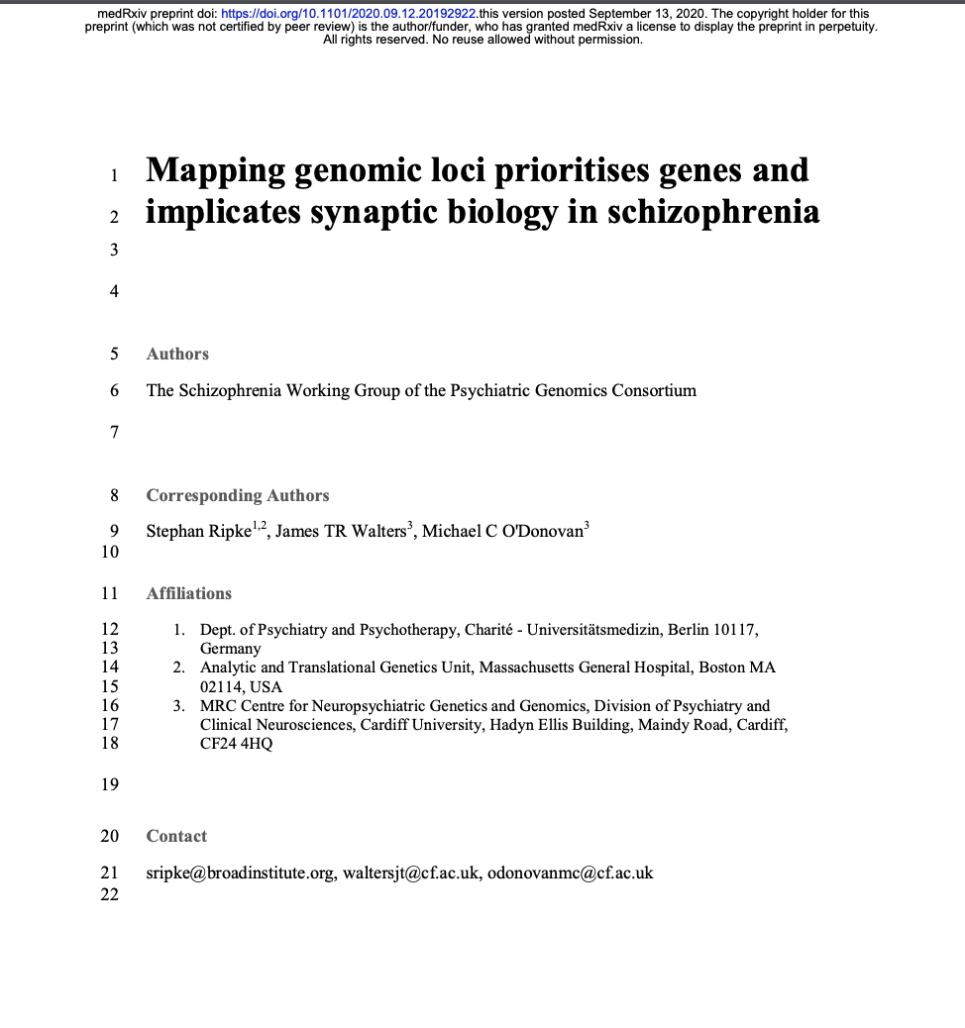

MedrXiv preprint
Schizophrenia working group chairs:
Michael O’Donovan (Cambridge)
James Waters (Cardiff)

Slide 3
Goal of this paper
1. Validation of associations between known genetic loci associated with schizophrenia
2. Discovery of new genetic loci associated with schizophrenia
3. Functional understanding of how genetic variance contributes to disease etiology and pathophysiology
Notes:
Hypothesis generating

Slide 4
Background
Pathophysiology of schizophrenia poorly understood
Heritability of schizophrenia >50%, likely 60-80%
→ Strong rationale to understanding genetic determinants of SCZ
GWAS: genome-wide association study
Study relationship of genetic features with disease status

Slide 5
GWAS Model
Generally:
Linear model on large case/control N of form:
Case/control ~ genetic feature + age + sex + confounders + genetic PCs
Just Y ~ mX + b

Slide 6
What’s the “genetic feature” ?
Single nucleotide polymorphisms (SNPs)
Case/control ~ genetic feature + age + sex + confounders + genetic PCs

Slide 7
What’s the “genetic feature” ?
Somewhat more recently:
Copy-number variants (CNVs)
Structural variants (SVs)
Rare coding variants (RCVs)
Case/control ~ genetic feature + age + sex + confounders + genetic PCs

Slide 8
GWAS cohort in this study
Primary GWAS:
90 cohorts
67,390 cases
94,015 controls
Ancestry:
~80% European
~20 East Asian

Slide 9
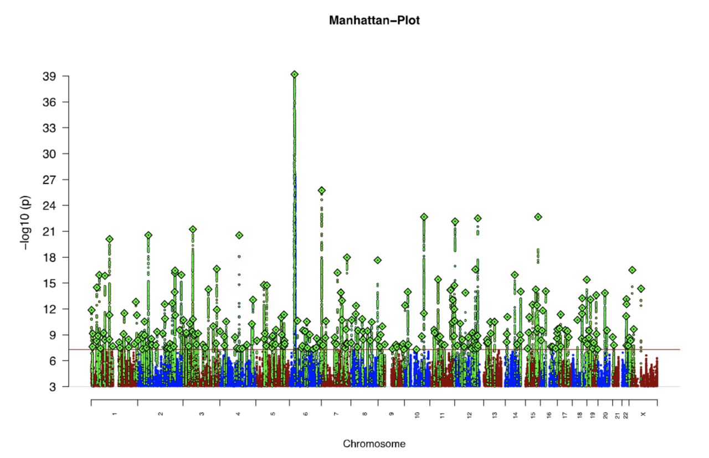
Primary GWAS Results
294 independent SNPs

Slide 10
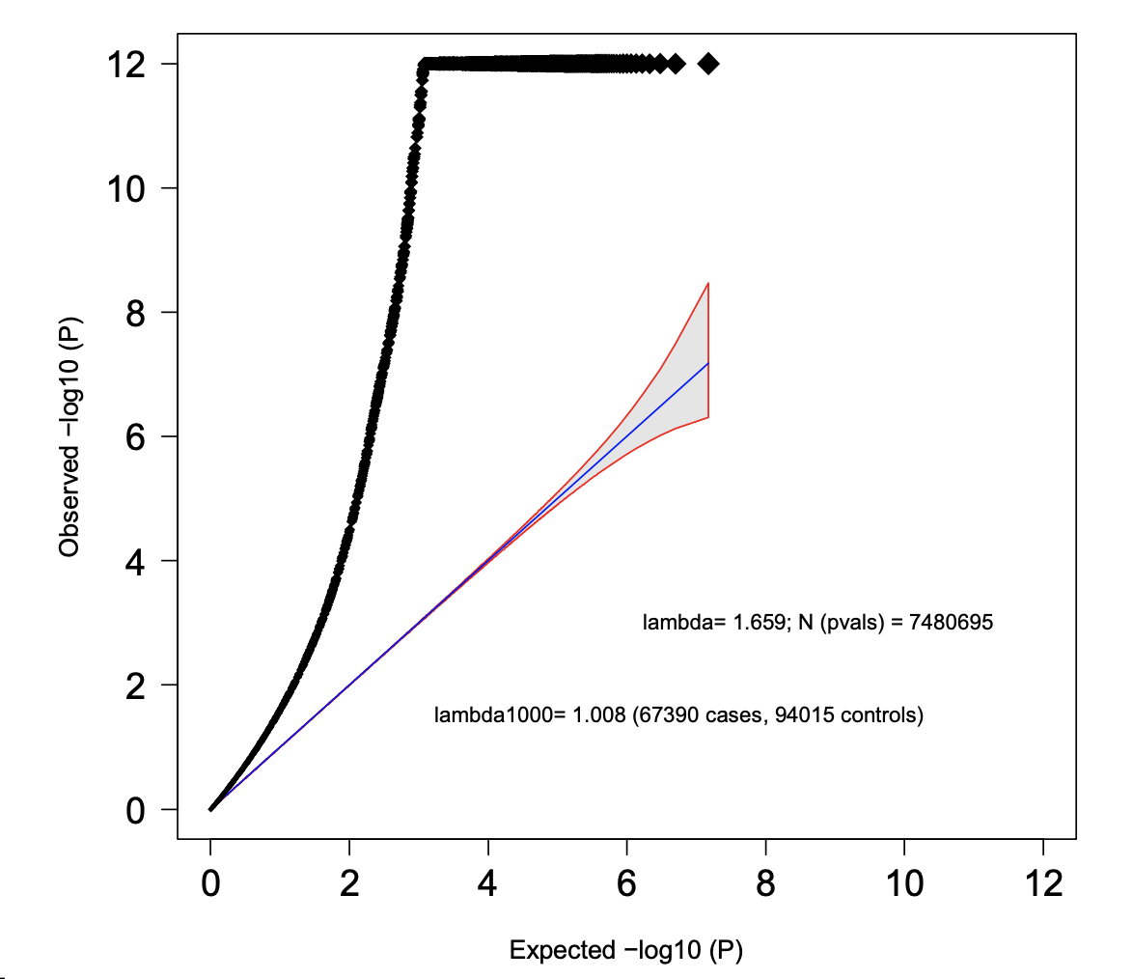

Slide 11

Validation GWAS
deCode Genetics:
~ 2,000 cases, 142,000 controls

Slide 12
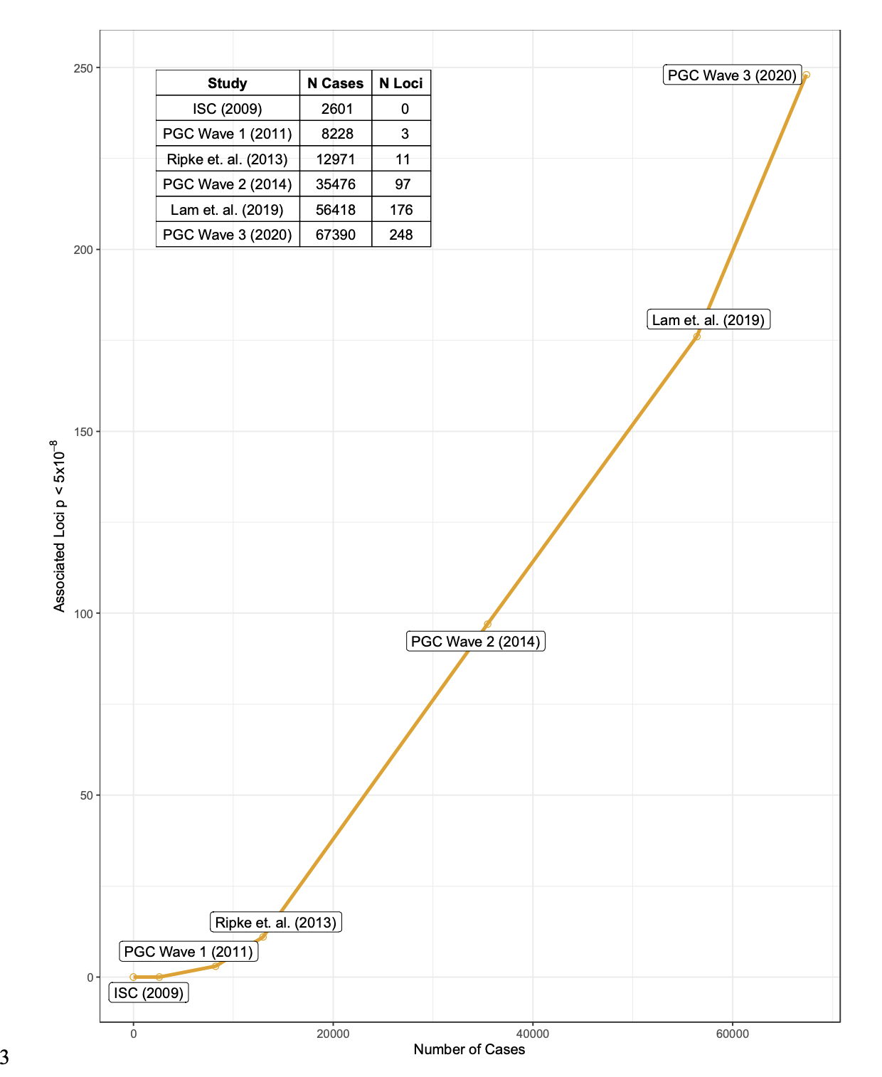
Number of variants discovered increases with case count

Slide 13
Heritability Estimates from Discovered SNPs
h²_{Schizophrenia} = 0.6-0.8
h²_{SNP} = 0.24
Missing heritability: ~0.4

Slide 14
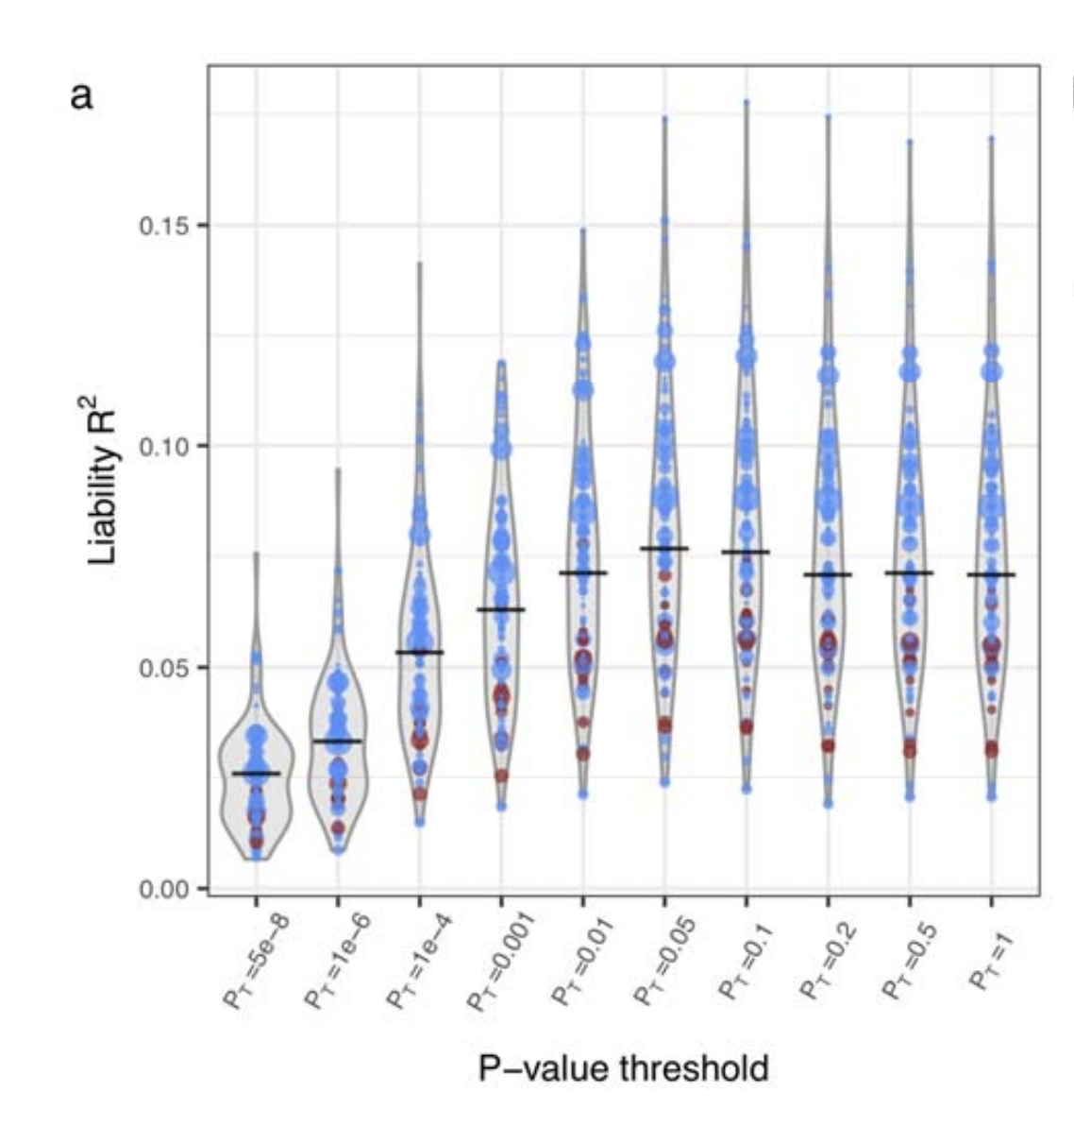
Polygenic Risk Score Prediction
~7%

Slide 15
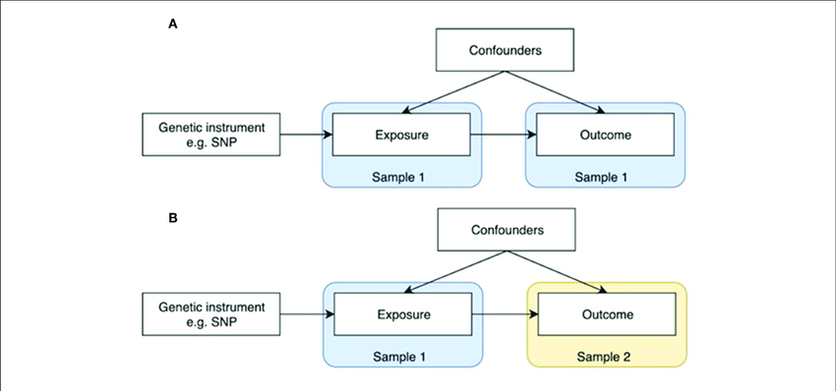
More interesting: Mendelian Randomization
MR = causal inference method to determine if X causes Y using genetic instruments as proxy variables

Slide 16
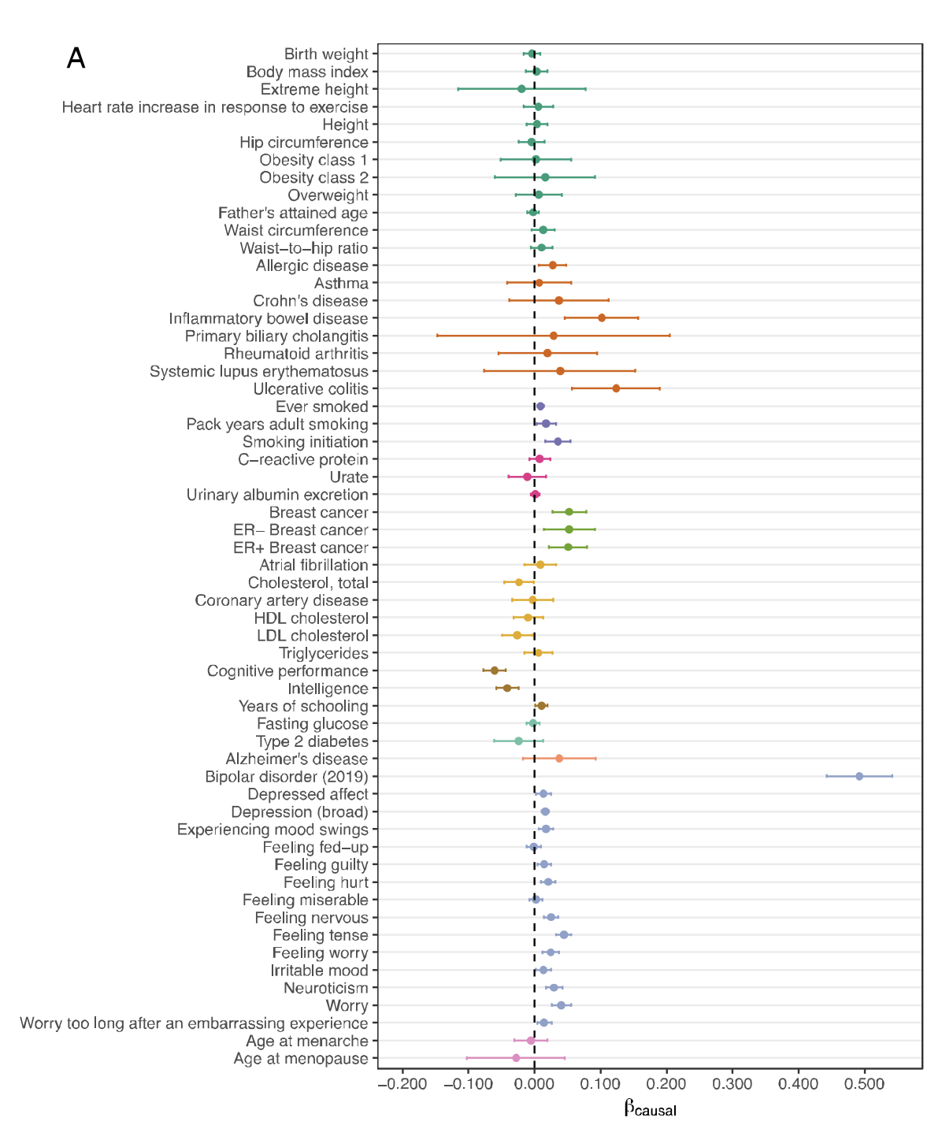
Schizophrenia as exposure

Slide 17
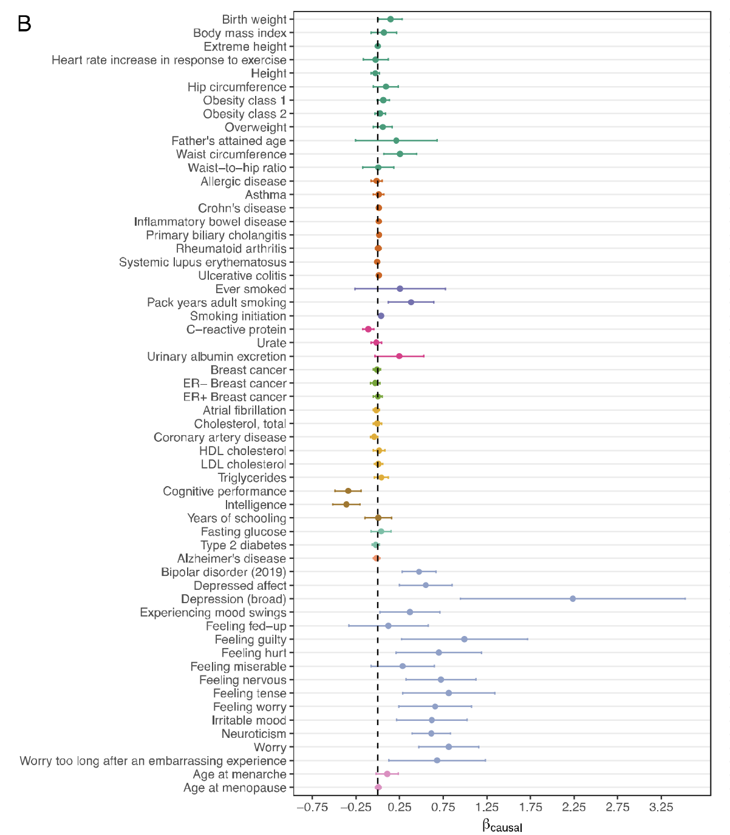
Schizophrenia as outcome

Slide 18
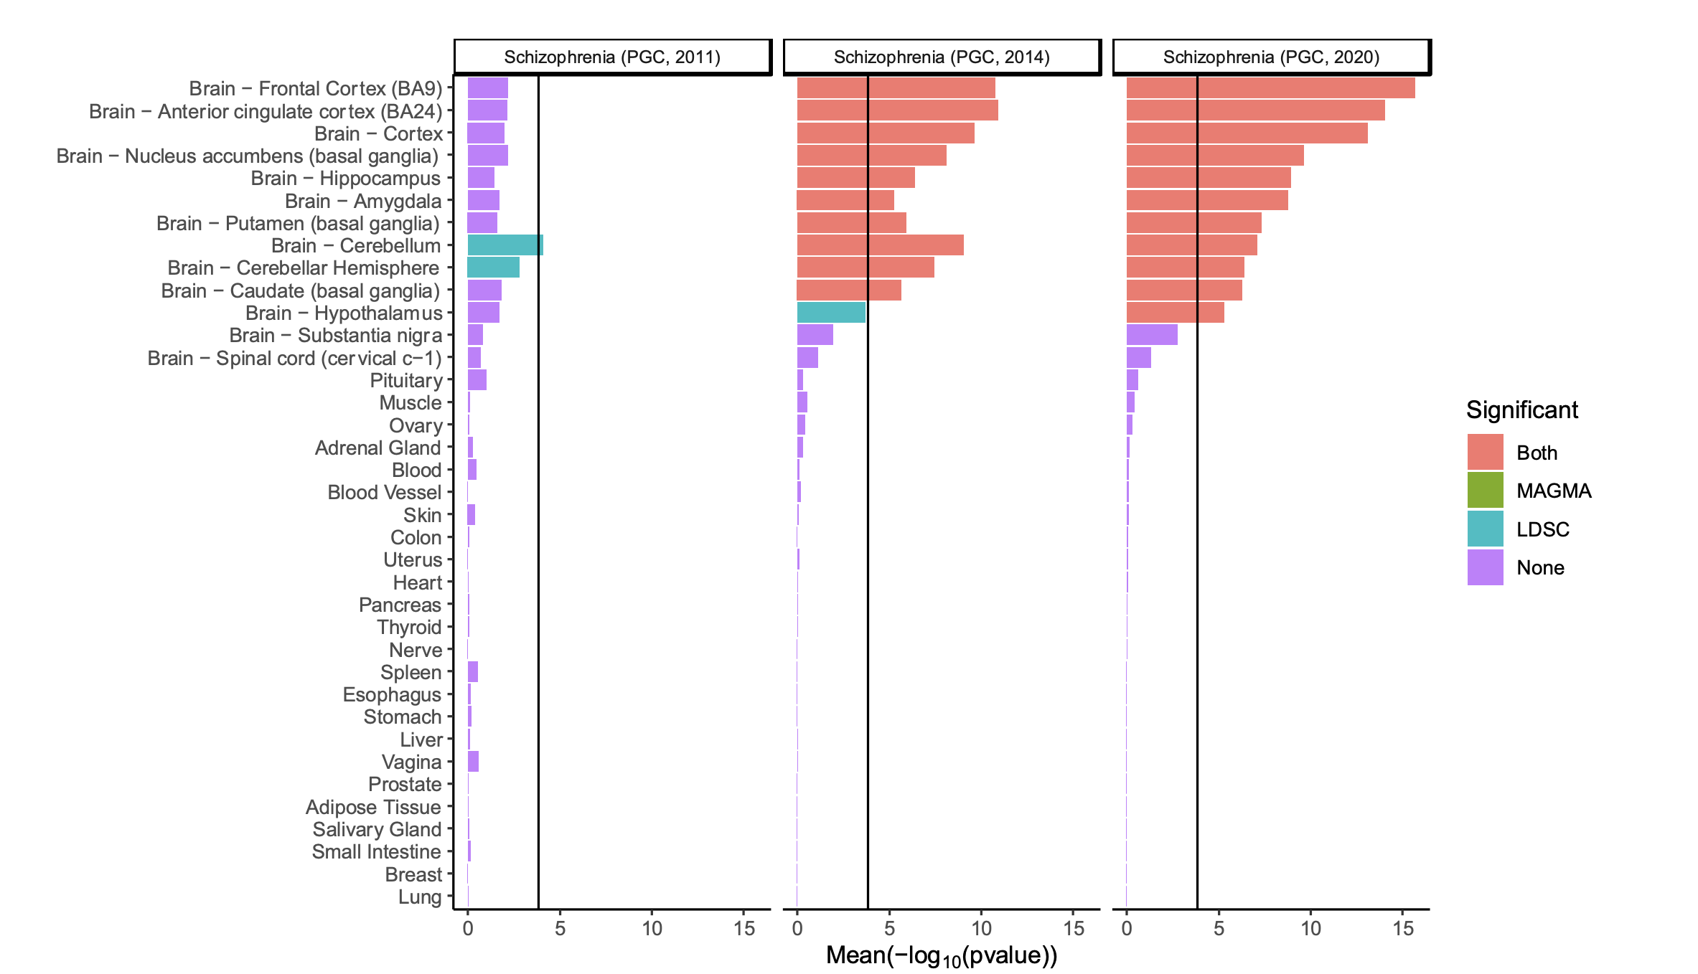
SCZ vs. Brain Region Genes

Slide 19
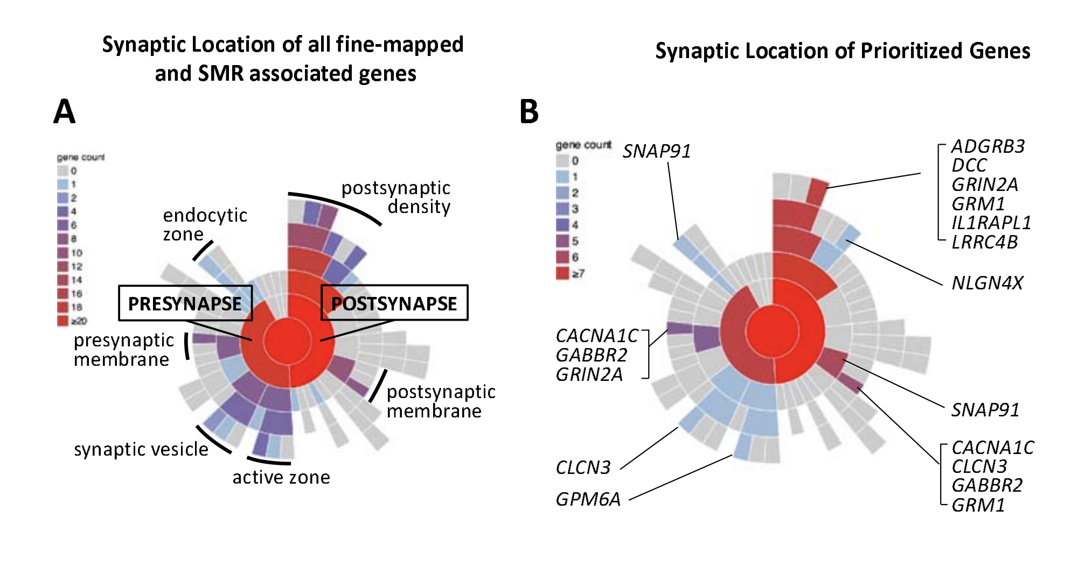
Notes:
377 Figure 5: Mapping of all FINEMAP/SMR genes (A) and prioritized genes (B) to synaptic locations using SYNGO. 378 Sunburst plots depict synaptic locations with child terms in concentric rings, starting with the synapse (center), pre- and 379 postsynaptic locations in the first ring and child terms in subsequent ring. The number of genes in each term is indicated by 380 the colour scheme in the legend. FINEMAP/SMR genes are those tagged by at least one credible SNP identified by 381 FINEMAP or which are associated using SMR (N=437 protein coding genes) of which N=50 are SynGO annotated, 44 to 382 cellular components. Prioritized genes are the subset of protein coding genes identified as likely to be causal (Extended 383 Data Table 1; N=114) using the prioritization criteria described in the main text of which 13 are SynGO annotated, 12 to 384 cellular components. Genes were annotated using the SYNGO synaptic location database (www.syngoportal.org) which is exclusively based on expert annotation of published evidence (see Koopmans et al25 385 ).

